Slide 1
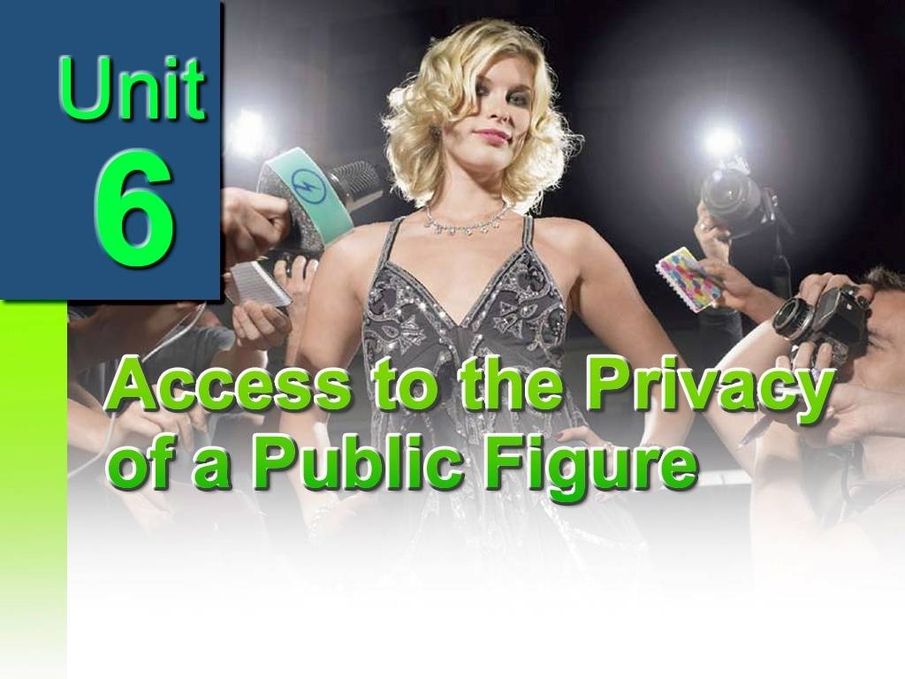
In this unit, you are expected to learn
a
about people’s attitudes toward the access to the privacy of a public figure;
b
how a paragraph is structured;
c
how to carry out a debate on media and privacy of a public figure.

Slide 2
Detailed reading
1. Difficult Sentences
2. Words and expressions

Slide 3
Difficult Sentences:
Contrary to public opinion, celebrities’ lives do not belong to the public! They belong to the individuals who have the mixed blessing /curse of being famous. (Para5)
与普通人的观点相反，名人的生活不属于大众，而属于他们自己！做名人既受人爱羡，也遭人诅咒。

Slide 4
2. A huge factor in many celebrity divorces was the inability of one spouse to deal with the hectic publicity that followed them everywhere. The paparazzi have a lot to answer for, but so do we! (Para9)
许多名人离婚的一个重要原因就是配偶不能忍受时时刻刻跟随他们的过分曝光。对此不仅狗仔队需要负责任，我们也同样需要负责任！

Slide 5
3. Of course, some celebrities do seem to ask for bad publicity when they make spectacles of themselves in public, but nonetheless, no one deserves to have every moment of their lives documented for the public eye! (Para10)
当然，一些明星在公众出洋相是为了炒作出名。但是，没人愿意把生活的每一片刻都曝光于众！

Slide 6

Words and Expressions
celebrity (Para1)
quality time (para2)
at the best of times (para3)
unflattering (para.3)
experience/have a bad hair day (para.3)
exclusive (Para4)
hound (para.5)
in the spotlight (para.6)
obsess (about/over) (para.6)
Have a lot to answer for (para.9)
stand/place/be in the shoes of (para.9)
make spectacles of oneself (para.10)
nonetheless (para10)
grueling (para.12)

Slide 7
Words and Expressions
1.celebrity: a famous living person [= star]: 名人(celeb, star )
a sporting celebrity
He's a national celebrity.
We invited a number of minor celebrities (=people who are not very famous).
2 [uncountable] （formal） the state of being famous [= fame] 名声
similar words: well-known, celebrated, renowned, eminent, noted
famous for doing something bad: notorious, infamous(声名狼藉的）
not famous: little-known, unknown, obscure （模糊的）
figure: someone who is important or famous in some way
Public figure: either a public official or any other person pervasively （普遍地）involved in public affairs 公众人物
celebrity advertising is the use of a public figure’s likeness for the purpose of selling a product or service. Celebrity advertising can be accomplished through celebrity endorsements(签注), whereby the celebrity consents for his or her likeness to be used in advertisements for a certain brand.

Slide 8
2. quality time: If people spend quality time together, they spend a period of time relaxing or doing things that they both enjoy, and not worrying about work or other responsibilities.优质时间，宝贵时光（指放松自我、享受乐趣的时间） Gives an old man a chance to spend more quality time with his
granddaughter.给老人创造机会能花更多的宝贵时间和他的孙女在一起。
quality newspapers/press etc (British English) newspapers etc intended for educated readers (供有品位者阅读的）高端报纸
quality assurance 质量保证

Slide 9
3. at the best of times:在最有利的情况下,在情况最好时候
Life on the sea was, at the best of times, very uncomfortable and monotonous.海上的生活，即使在情况最好时也不自在而且十分单调.
In china, these power transitions are carefully orchestrated so that the new leadership can come into power at the best of times, strengthening the legitimacy of the government and party and
showing their power in a positive light.
在中国，这类权力交接往往经过精心编排，以便新领导层可以在最佳状态下得到权力，以加强政府和党的合法性，同时以正面形象展示其权力.

Slide 10
4. unflattering: adj.
Words and Expressions
If you describe something as unflattering, you mean that it makes a person or thing seem less attractive than they really are. 贬低的；有损形象的
It finds the most common triggers for women to start dieting was seeing their reflection in the mirror, preparing for a summer holiday or unflattering photos posted on social networking sites.
研究发现女性开始节食最常见的起因是看到“镜子中的自己”，或为夏天的假期做准备，或是因为上传到社交网站上的的照片有损形象。
由于呆板的发型和风格全无的着装，她看起来就像一个老妇女。
She comes across like an old woman with her unflattering hairstyle and shapeless clothes.
flatter vt. If someone flatters you, they praise you in an exaggerated way that is not sincere, because they want to please you or to persuade you to do something. 奉承;讨好
I knew she was just flattering me. 我知道她只是在恭维我.

Slide 11
5. experience/have a bad hair day: People sometimes say they are having a bad hair day when they do not feel very happy or relaxed, have a day when nothing seems to be going right 暗示一整天都不顺利，不顺心的一天,心情不好
This morning I overslept. And then I was late for work and missed an important meeting. Next I lost my mobile phone in a restaurant at the lunch time. Then to top this off, I spilt coffee on my new skirt. This is really a bad hair day!
就算你倒霉了一整天， 也不代表是世界末日啊。
It’s not the end of the world even if you have a bad hair day.
Words and Expressions

Slide 12
6. exclusive: 1. available or belonging only to particular people, and not shared
exclusive access/rights/use etc
Our figure skating club has exclusive use of the rink（溜冰场） on Mondays.
exclusive report/interview/coverage/column
Tune in to our exclusive coverage of Wimbledon.
exclusive to sb---
This offer is exclusive to readers of The Sun.
2. exclusive places, organizations, clothes etc are so expensive that not many people can afford to use or buy them:
Bel Air is an exclusive suburb of Los Angeles.
an exclusive girls' school
3. deliberately not allowing someone to do something or be part of a group:
4. mutually exclusive：if two things are mutually exclusive, you cannot have or do both of them:
Lesbianism and motherhood are not mutually exclusive.
5. exclusive of something: not including something [≠ inclusive of sth]:
Our prices are exclusive of sales tax.
6. concerned with only one thing:
The committee's exclusive focus will be to improve public transportation.
独用的;独有的;独享的
专用通道,专有权,专用
专门的报告/专访/专门的报道/专栏
专为…所独有
高档的,高级的，奢华的
排外的，排斥的
互相排斥的
不包括
单独的, 唯一的

Slide 13
7. hound: vt. constantly disturb or speak in an annoying or upsetting way; pursue or chase relentlessly
不断地烦扰；叨唠，纠缠; 追猎；追捕
From the start of the season, the NBA star has been hounded by the press.
从本赛季一开始，这位NBA球星就不停地遭到媒体的骚扰。
警方已保证要追查此次爆炸事件有责任的人员。
The police have promised to hound down those responsible for the explosion.
Words and Expressions

Slide 14
8. in the spotlight: at the center of attention, to get attention and interest from the public.
处于公众注意的中心；出风头
He likes to be in the spotlight.
他喜欢出风头。
运动员们想要挣更多的钱，发展自己的事业，享受成为焦点的感觉。
Sport players want to go to earn more money, further their careers and bask(晒太阳) in the spotlight.
Words and Expressions

Slide 15
Words and Expressions
9. obsess (about/over)：
If something or someone obsesses you, you keep thinking about it and find it difficult to think about anything else.
（使）着迷；使…困扰；（使）心神不宁
be obsessed by/with something/somebody
A lot of young girls are obsessed by their weight.
be obsessing about/over something/somebody: to think about something or someone much more than is necessary or sensible:
Stop obsessing about your hair. It's fine.
  她戒了酒，但又开始执著于体重问题。
  She stopped drinking but began obsessing about her weight.
  美国正被一系列丑闻所困扰。
  A string of scandals is obsessing America.

Slide 16
Words and Expressions
10. have a lot to answer for: 1) If you say that someone has a lot to answer for, you are saying that their actions have led to problems which you think they are responsible for. （对问题）负有很大责任
2) If you have to answer for something bad or wrong you have done, you are punished for it. 为了…而受惩罚；为…付出代价
He must be made to answer for his terrible crimes.
他必须为他的严重罪行付出代价。

Slide 17
11. stand/place/be in the shoes of: be in other’s situation/position 站在别人的位置上，设身处地, 换位思考
If you stand in his shoes to view the problem, you will come to a totally different conclusion.
如果你站在他的立场上考虑这个问题，你会得出完全不同的结论。
通过换位思考，我们可以极大地扩展自己的视野。
We can expand our horizons by standing in the other’s shoes.
Words and Expressions

Slide 18
Words and Expressions
12. make spectacles of oneself: make a show of oneself; make a fool of oneself; become a laughing stock 使自己出丑，出洋相
He got drunk and made a spectacle of himself in the club. 他喝得酩酊大醉，在俱乐部大出洋相。
有时候他的演说很成功, 有时候却大出洋相，当众出丑。
Sometimes he is a successful speaker, but sometimes he makes spectacles of himself.
or: make a show of oneself/
make a fool of oneself

Slide 19
Words and Expressions
13. nonetheless: = nevertheless: in spite of the fact that has just been mentioned 虽然如此，但是
The region was extremely beautiful. Nonetheless, Gerard could not imagine spending the rest of his life there.
There was still a long way to go. Nonetheless, some progress had been made.
路还很长，不过已经取得了一些进展。
The paintings are complex, but have plenty of appeal(有吸引力) nonetheless.

Slide 20
grueling: adj. characterized by toilsome effort to the point of exhaustion, especially physical effort
紧张的，激烈的，使极度疲劳的
We got home after a grueling drive.
经过一段令人精疲力竭的开车旅程，我们到家了。
Eighty million high school students in China have already taken this grueling test.
有8000万的中国高中生都已经参加过这个“独木桥”考试.
Words and Expressions

Slide 21
After Reading
Useful Expressions
Listening
Who should be blamed for Diana’s death ?
Translation
Paragraph Translation
Group Discussion
VI. Writing

Slide 22
Useful expressions
1.特别的职业 1. extraordinary careers
2.宝贵时光 2. quality time
3.在某种程度上来说 3. to some extent
4.给某人照相 4. have photos taken/ snapped of sb
5.穿着很不好看的衣服 5. be dressed in highly unflattering clothes
6.在情绪最好时 6. at the best of times
7.没有化妆 7. have no make-up on
8.度过倒霉一天 8. experience a bad hair day
9.八卦杂志 9. tabloid magazine
10.高档餐厅 10. exclusive restaurant
11.与普通人的观点相反 11. contrary to public opinion
12.做名人既受人爱羡，也遭人诅咒
12. have the mixed blessing/curse of being famous
13.成为焦点 13. in the spotlight
14.为···所困扰 14.obsess about---

Slide 23
15.变得不可收拾 15. reach the point of no return
16.通过滴注器为她补充营养 16. feed sb. via a drip
17.死于厌食症 17. die of anorexia
18.生活在大众的眼皮底下 18. live in the public eye
19.变本加厉 19. shoot to the sky
20.超速驾驶 20. speed up
21.不尊重人们的生活 21. have no respect for human life
22.宽待某人--- 22.extend grace to sb
23.某人对做某事无能为力 23.inability of sb to do sth.
24.需要负责任 24. have a lot to answer for
25.处于···地位或处境 25.put/place/ be in the shoes of sb.
26.炒作出名 26.ask for bad publicity
27.出洋相 27. make a spectacle of oneself
28.电影首映式 28. movie debut
29.极度紧张的工作 29. a grueling job
30.增加他们的压力 30. add to one’s stress

Slide 24
Translation Practice
1. 我的晋升对我来说是喜忧参半,因为这意味着我与家人在一起的时间减少了。(blessing/curse)
Getting the promotion was a mixed blessing / curse because it means I spend less time with my family.
2. 他因无力还债，而锒铛入狱。( inability to do)
His inability to pay the debt puts him in chains and throws him to prison.
3.如果我们处在名人的位置，到处被跟踪，得不到片刻的安宁，我们会喜欢吗？(in the shoes of )
Would we like it if we were in the shoes of celebrities who were continually followed everywhere and could not get a moment’s peace?

Slide 25
4. 关于个人的隐私权和公众的知情权，通常没有明显的是非界限。(on the issue of---)
On the issue of the right to individual privacy and the right for public to know, there’s often no clear-cut distinction between right and wrong.
5.中国人在经济最好的光景里都有强烈的储蓄意愿。
(at the best of times)
Chinese have a strong tendency to save money even at the best of times.
6.她设法使他们平静下来，不想却适得其反。
(make the matter worse)
Her attempts to calm them down only made the matter worse.

Slide 26
Paragraph Translation
名人也应有享受正常生活的权利。他们和普通人一样，用自己喜欢的方式去安排自己的生活。有些名人一天要辛苦工作16到20个小时，我们没有权利去增加他们的烦恼！地球上的每一个人都是单个个体，我们每一个人都应有独自的个人生活。

Slide 27
Celebrities, too, deserve the chance to live a normal life. They, like normal people, try to live their lives the best way they think possible. Some celebrities work sixteen to twenty hours a day in a grueling job. We have no right to add to their stress! Every single person on this Earth is an individual and each of us deserves to live an individual life.

Slide 28
非主讲课文：
Privacy and Public Interest

Slide 29
I. Vocabulary
1. abusive adj. 虐待的；攻击性的 (Para 2)
e.g. Good manners ban abusive language anywhere。
He became abusive and his wife was injured in the struggle.
2. blackmail v. 敲诈，勒索 ,要挟 (Para6)
e.g. The strikers refused to be blackmailed into returning to work.
They hijacked the plane to blackmail the government.
3. asset n. 资产，财产 (Para6)
e.g. He is a most valuable asset to the firm.
Sociability is a great asset to a salesman.
4. overlap n. 重叠 （Para9）
e.g. There is no question of overlap between the two courses.
There is large overlap between these two books.
5. plea n. 请求 (Para12)
e.g. The prisoner‘s plea for pardon (赦免)was rejected.
The counsel (辩护人) for the plaintiff （原告）closed his case with a plea for damages.

Slide 30
Where -clause
一. Where状语从句在句首:含有对比(contrast)意味 .
当Where引导的状语从句置于句首时,这个从句与主句在语义上可以形成对比的意味。比如下面这句话:
eg. Where most people saw nothing but a hardened criminal, I saw a lonely and desperate man. 许多人只看见一个冷酷无情的罪犯,但我看到的却是一个孤独而绝望的男人。
在这个例句中,where所引导的状语从句与后面的主句在内容上形成了鲜明的对比,这便体现了where引导的状语从句放在句首时的语义特点之一 ——对比意味。

Slide 31
二、Where状语从句在句首:含有条件(condition) 意味
Where引导的状语从句放在句首,也可以表达条件的意味。比如在奥巴马就职演说中有这样一段话:
eg：The question we ask today is not whether our government is too big or too small, but whether it works, whether it helps families find jobs at a decent wage, care they can afford, a retirement that is dignified. Where the answer is yes, we intend to move forward. Where the answer is no, programs will end.
今天,我们的问题不在于政府的大小,而在于政府能否起作用、能否帮助每个家庭找到薪水合适的工作、能否提供他们可以负担得起的医疗保障并让他们体面地退休。哪个方案能给予肯定的答案,我们就推进哪个方案。哪个方案给予的答案是否定的,我们就选择终止。
在这一例句中,我们可以发现,“the answer is yes”是“move forward (继续推行方案)”的条件,而“the answer is no”是“program will end (终止方案)”的条件。

Slide 32
另外,英语中有“Where there is …, there is …”这样的句式,其中where引导的状语从句同样具有条件意味。现列出几句,供读者揣摩:
Where there is a will, there is a way.
(有志者,事竟成。)
Where there is life, there is hope.
(留得青山在,不怕没柴烧。)
Where there is love, there is hope.
(有爱,就有希望。)
Where there is great love, there are always miracles. (哪里有真爱,哪里就有奇迹。)

Slide 33
三、Where状语从句在句首:含有时间(time)意味
奥巴马在胜选演说中,使用了著名的“Yes we can”排比句,其中最后一句是这样说的:
eg: where we are met with cynicism, and doubt, and those who tell us that we can’t, we will respond with that timeless creed that sums up the spirit of a people: Yes we can.
当我们遇到嘲讽和怀疑,当有人说我们办不到的时候,我们要以诠释了美国精神的这个永恒的信条来回应他们:不,我们能做到。
在本句中,地点状语从句“where we are met with cynicism, and doubt, and those who tell us that we can’t”就含有时间的意味,表示“当我们遇到嘲讽和怀疑,当有人说我们办不到的时候”。

Slide 34
II. Multiple Choice
1. Although regarded as the " cleanest" TV network, CBS had 3.2 scenes of violence and _______ language per hour.
A. native B. abusive C. professional D. common
2. He tried to use the sexual scandal to_________ the mayor.
A. support B. elect C. resign D. blackmail
3. Her achievement proved herself a/an ______ to the company.
A. possession B. asset C. property D. fortune
4. The project found that more than 25 percent of DNA _______ between human and dog.
A. overlap B. gap C. repetition D. similarity
5. His _____ for mercy was rejected by the judge.
A. pray B. begging C. plea D. claim

Slide 35
II. Expressions
1. 明确的界限（区别） clear-cut distinction
2. 关于---的问题 on issues of---
3. 恢复到----- revert to--- (doing )
4. 把---融为一体 merge sth and /with sth
5. 模糊界限（区别） blur the distinction
6.屏幕内外的个性 on-screen and off-screen personalities
7. 认定---范围 recognize the limits
8. 设定道德基调 set a moral tone
9.要挟某人做某事 blackmail sb into doing sth
10.影响合同签订 influence the awarding of contracts
11. 分界线 a dividing line
12. 侵犯个人隐私 invade the person’s privacy
13. 隐私权 the right to privacy
14. 总理 prime minister

Slide 36
15. 有权享有-- - be entitled to sth
16. 优待 preferential treatment
17.滥用职权 abuse one's authority
18. 关于隐私问题 in the matter of privacy
19. 呼吁 make a plea for---
20. 扮演幻想的角色 play a fantasy role
21. 促进自己良好的公众形象 promote a good image of oneself
22. 曝光自己的不良素质 expose one’s bad qualities
23. 描绘自己 portray oneself
24. 获得额外的知名度 gain extra publicity
25. 要求私人生活远离媒体关注
demand a private life away from media attention

Slide 37
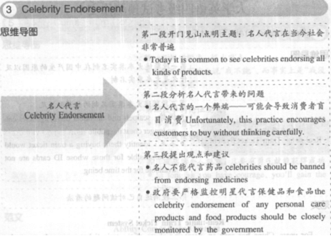
writing
Celebrity Endorsement

Slide 38
Sample
Currently, we could hardly live a single day without seeing a celebrity spokesperson promoting a product or a social campaign on TV, net or other media. This is an intensely popular trend that we cannot fail to notice.
Unfortunately, this practice encourages customers to buy without thinking carefully. Of course, companies do not consider it to be a problem. However, when a celebrity's picture unintentionally appears on medicine, food or even sports equipment that may be harmful to people's health, his popularity increases the potential damage of the product greatly.
In my opinion, celebrities should be banned from endorsing medicines, since medicine should be purchased only after the customer considers carefully whether it is truly necessary. In addition, the celebrity endorsement of any personal care products and food products should be closely monitored by the government agencies responsible for the public health and safety.

